Slide 1
A CASE STUDY PRESENTATION ON GESTATIONAL DIABETES
BY
MAMAH, CHINEMEREM PERPETUA
SUPERVISOR DTN. ONYEKWELU CHIMDINDU CHIZITELU.
NOVEMBER, 2024

Slide 2
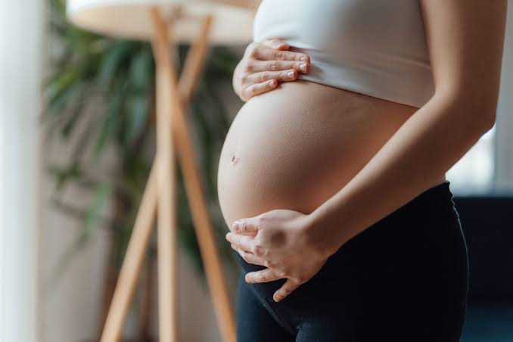
PREGNANCY OVERVIEW
Pregnancy is a complex stage of life during which a mother serves as the sole source of nourishment to support fetal growth and development. Within 40 weeks, a fertilized egg develops into a human being, and the mother supports this process through the nutrients and functional compounds she provides.

Slide 3
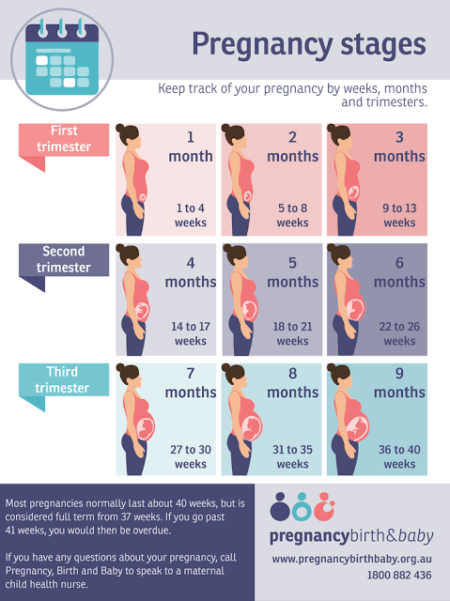

Slide 4
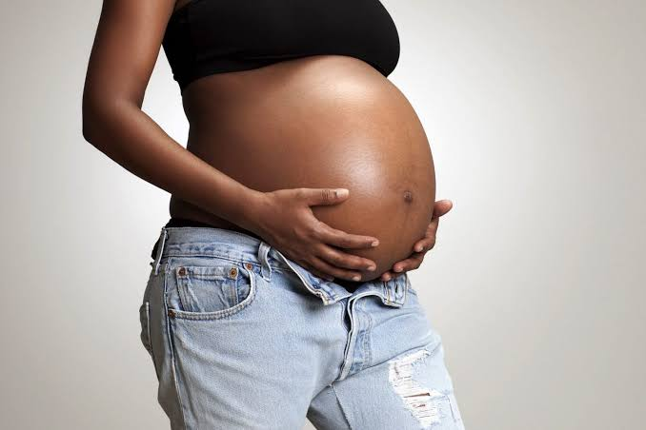
OVERVIEW CONT’D
From the time of conception until 40 weeks of gestation, a foetus is fully dependent on its mother for nourishment. Maternal factors such as pre-pregnancy nutritional status, pre-pregnancy weight status, gestational weight gain, the presence of comorbidities, gravida (number of pregnancies a woman has experienced) and parity (number of births a woman has given in her lifetime), smoking status, and maternal behaviour can therefore directly influence birth weight, health and outcomes.

Slide 5
Pre-pregnancy weight alone has been shown to significantly impact the mother’s health and weight gain during pregnancy, as well as the health of her child at birth. These maternal behaviours, along with the provision of adequate, under or overnutrition throughout gestation (the time between conception and birth) can affect the genetic and metabolic components of the foetus and may result in epigenetic changes in the infant.

Slide 6
High-Risk Pregnancy Factors
Factor | Condition That Raises Risk
Maternal weight Prior to pregnancy During pregnancy | Pre-pregnancy BMI either <18.5 or ≥25 Insufficient or excessive pregnancy weight gain
2. Maternal nutrition | Nutrient deficiencies or toxicities; eating disorders
3. Socioeconomic | status Poverty, lack of family support, low level of education, limited food available
4. Lifestyle habits | Smoking, alcohol or other drug use
5. Age | Teens, especially 15 years or younger; women 35 years or older
6. Previous pregnancies • Number • Interval • Outcomes • Multiple births | Many previous pregnancies (3 or more to mothers under age 20; 4 or more to mothers age 20 or older) Short or long intervals between pregnancies (59 months) Previous history of problems Twins or triplets
7. Maternal health High blood pressure • Diabetes • Chronic diseases | Development of gestational hypertension Development of gestational diabetes Diabetes; heart, respiratory, and kidney disease; certain genetic disorders; special diets and medication

Slide 7
NUTRITION SUPPORT IN PREGNANCY
Enhancing maternal nutrition status prior to conception is the gold standard to managing a health pregnancy.
As gestation progresses, energy and protein needs increase and the growth of the foetus is altered by the nutrient supply provided. Supplementation of certain nutrients is highly recommended during pregnancy due to overall increased utilization. These include calcium, iron, folic acid and vitamin D. Folic acid intake or supplementation should be adequate prior to 21 days of gestation due to the closure of the neural tube.

Slide 8
With the increased mental, physiologic and biologic demands of pregnancy, prolonged nutritional deprivation in a pregnant woman increases the risk of nutritional deficiencies, dehydration, electrolyte imbalances, low birth weight infants, and even foetal death.
When indicated, providing nutrition support can play a pivotal role in preventing complications and adverse effects of nutrition deficit during pregnancy.

Slide 9
Nutrient Requirements During Pregnancy
Energy: Additional energy is required during pregnancy to support the metabolic demands of pregnancy and fetal growth. Metabolism increases by an average of 15% in the singleton pregnancy, but with wide variability especially in the third trimester. According to Institute of medicine the DRI for energy increases by only 340 kcal/day during the second trimester and by 452 kcal/day in the third trimester. If maternal weight gain is within the desirable limits, the range of acceptable energy intakes varies widely, given large individual differences in energy output and basal metabolic rate. Modifying intakes to achieve recommended weight gain is more useful than calculating caloric requirements.

Slide 10
Protein: Additional protein is required to support the synthesis of maternal and foetal tissues. This demand increases throughout gestation and is maximized during the third trimester. The baseline protein RDA of 0.8 g/kg current body weight/day for pregnant women is 46g only for someone with a prepregnant weight of 58kg. The protein calculation in the first half of pregnancy is the same as that for nonpregnant women but the required intake increases as weight increases. The RDA calculation increases in the second half of pregnancy to 1.1 g/kg current body weight/day. This would be 71 g/day only for that same reference woman who is also gaining weight appropriately. the protein requirement For each additional foetus, the Institute of Medicine (IOM) recommends an additional 50 g/day starting in the second trimester (Otten et al, 2006), but because protein is also used as an energy source, the total may be as much as 175 g/day for the normal-weight woman carrying a twin gestation who is consuming 3500 kcal/day (Goodnight and Newman, 2009).

Slide 11
Carbohydrates: The RDA for carbohydrates increases slightly, helping maintain appropriate blood glucose and prevent ketosis. Intakes may be greater in women consuming more calories, but careful carbohydrate choices are needed to include all the daily nutrients for pregnancy. Priority should be given to complex carbohydrates from whole grains, fruits, and vegetables rather than just simple sugars, including refined liquid sugars, whether natural (juices) or industrially produced (soda).

Slide 12
Fibre: Daily consumption of whole-grain breads and cereals, leafy green vegetables and fresh and dried fruits should be encouraged to provide additional minerals, vitamins and fibre. The DRI for fibre during pregnancy is 14 g/day/1000 kcal and if met, will help a great deal in managing the constipation that often accompanies pregnancy.
Lipids: As with nonpregnant women, there is no DRI for total lipids during pregnancy. The amount of fat in the diet should depend on energy requirements for proper weight gain. However, recommendations for omega-6 polyunsaturated fatty acid (PUFA) (linoleic acid) and omega-3 PUFA (alpha-linolenic acid) increase slightly. Although not a DRI, the recommended intake of DHA is 200 mg/day and can be met by one to two portions of fish per week (Carlson et al, 2017).

Slide 13
Vitamins and Minerals: All vitamins and minerals are needed for optimal pregnancy outcome. In some instances requirements may be met through diet. For others a supplement, started pre conceptually, is often necessary. Many, but not all, vitamin and mineral recommendations increase with pregnancy, but the magnitude of the increase varies by nutrient.
Fluids: Drinking 8 to10 glasses of quality fluid daily, mainly water, is encouraged. The DRI for fluid increases slightly during pregnancy, but a woman’s body size as well as climate conditions are important considerations. Adequate hydration improves the overall sense of wellbeing. Frequent urination is often a complaint from pregnant women. However, optimal hydration reduces risks for urinary tract infections, kidney stones, and constipation. In addition, dehydration can cause uterine irritability. Women often must be reminded to pay attention to their intake of liquids, using urine colour after the first morning void as a guide

Slide 14

Exercise: Energy expended in voluntary physical activity is the largest variable in overall energy expenditure. Physical activity increases energy expenditure proportional to body weight. However, most pregnant women compensate for increased weight gain by slowing their work and movement pace. Therefore total daily energy expenditure may not be substantially greater than before pregnancy. The ACOG recommends at least 20 to 30 minutes of moderate intensity exercise on most, if not all, days for pregnant women without contraindications (ACOG, 2015a). Short duration strenuous exercise appears unconcerning, but the impact of long duration strenuous exercise on the foetus is unknown (Szymanski and Satin, 2012).

Slide 15
GESTATIONAL DIABETES OVERVIEW
Gestational diabetes mellitus (GDM) is a high blood sugar (glucose)that develops during pregnancy and usually disappears after giving birth.
It happens when one's body cannot produce enough insulin due to pregenancy. Unlike type 1 diabetes, gestational diabetes is not caused by a lack of insulin, but by other hormones produced during pregnancy that can make insulin less effective, a condition referred to as insulin resistance.

Slide 16
TYPES OF GESTATIONAL DIABETES MELLITUS
They include
A1GDM and A2GDM
AIGDM: is managed without medication and responsive to nutrition therapy(diet controlled gestational diabetes).
A2GDM: is gestational diabetes managed with medication to achieve adequate glycemic control.

Slide 17
SIGNS AND SYMPTOMS OF GESTATIONAL DIABETES
Excessive thirst( Polydipsia)
Excessive urination ( Polyuria)
Excessive hunger (Polyphagia)
Dry mouth( xerostomia)
Blurred vision
Genital itching

Slide 18
PRE-DISPOSING FACTORS OF GDM
Pre-eclampsia: a condition that causes high blood pressure in pregnancy and can lead to pregnancy complications if not treated
Obesity or haven given birth to a Child who weighed 4kg or more
Family history of type 2diabetes
Age (women who are older than 25 are at a greater risk for developing gestational diabetes than younger women)
Pre-diabetes or haven had GDM in previous pregenancies or a baby who was still born.
PCOS: Polycystic ovarian syndrome, a hormonal disorder causing enlarged ovaries with small cysts on the outer edges.

Slide 19
COMPLICATIONS OF GDM THAT MAY AFFECT THE CHILD
If the mother has gestational diabetes, the baby may be at increased risk of
Early ( preterm/ still)birth: high blood glucose may increase the risk of Early labour and delivery before the due date. Or Early delivery may be recommended because the baby is large.
Excessive birth weight: if the mother's blood sugar level is higher than the normal range,it can cause the baby to grow too large.
Serious breathing difficulties: babies born early may experience respiratory distress syndrome- a condition that makes breathing difficult.
Obesity and type 2 diabetes later in life: babies have a higher risk of developing Obesity and type 2 diabetes later in life

Slide 20
COMPLICATIONS THAT MAY AFFECT THE MOTHER
High blood pressure and pre-eclampsia
Having a surgical delivery ( C-section)
Future Type 2 diabetes

Slide 21
HOW IS GDM DIAGONISED?
GDM can be diagonised through
Oral glucose tolerance test (OGTT): This measures blood glucose after fasting at least 8 hours which a sample will be taken and 2 hours after taking something sweet to see how the body handles the sugar.
Glucose challenge test: this measures blood glucose after an hour of drinking sugary drink

Slide 22
MANAGEMENT OF GDM
Through close monitoring during pregnancy and birth to check for any potential problems.
Best to give birth before 41 weeks. Induction of labour or a caesarean section may be recommended if labour does not start naturally by this time.
Eating healthy: Choosing foods high in fiber like whole grains and low in fat and calories can help. Also watching portion sizes.
Physical activity: Exercise before and during pregnancy can help protect one from developing gestational diabetes.
Starting pregnancy at a healthy weight can help reduce risk

Slide 23

MEDICAL NUTRITION THERAPY

Slide 24
I hereby present an obstetrics and gynaecology case of a 31 year old pregenant woman being managed for gestational diabetes mellitus
Ward: Antenatal Ward
Consultant: Dr. Ohor, Dr. Idimma
Medical Diagnosis: GDM with bad obsteric Hx and a booked G4P3A1
Date of admission: 20/10/2024
Date case commenced: 29/10/2024
Date of discharge: 14/11/2024
Informant: Patient

Slide 25
Nutrition Assessment
Family and Social History
Patient hails from Isi Alangwa North and resides at Umuvom Bende road Umuahia Abia State. Married into a monogamous home with one female child.
She is a Christian and a member of 7th day adventist Church
Patient is a Civil servant and her highest level of education is O’level
Patient and family lives in a rented, well ventilated 2 bedroom apartment
Their mode of fecal disposal is water cistern and their source of drinking water is sachet water and pipe borne water.

Slide 26
Past Medical History
Patient is a known diabetic for 4years
Has a Family history of Diabetes
Patient has a bad obsteric history and a booked G4P3A1
She has been admitted admitted and transfused before
Patient has no known drug allergy
Has no history of HEAS
Present Medical History
Patient was admitted after antenatal visit due to elevated blood glucose level and is being managed for GDM

Slide 27

Antenatal History
Commenced routine drugs at 10wks and has been consistent
Patient has been consistent with her weekly antenatal visits

Slide 28
Anthropometry
Pre pregnancy Weight =70kg
Height = 1.60m
BMI= 27.3kg/m² (Overweight)
Pregnancy weight= 90kg
MUAC= 36cm

Slide 29
Biochemical Assessment
u/cr test
Test | Date | Value | Normal Range | Indication
Urea | 20/10/2024 | 5mg/dl | 13 - 42 mg/dl | Low
Creatinine | 20/10/2024 | 0.1 mg/dl | 0.5 - 1.5 mg/dl | low
Urea | 04/11/2024 | 11mg/dl | 13 - 42 mg/dl | Normal
Creatinine | 04/11/2024 | 0.5 mg/dl | 0.5 - 1.5 mg/dl | Normal
FBS on admission : 127 mg/dl
FBS on discharge : 125mg/dl

Slide 30
Nutrition Focused Physical Findings
O/E, a pregenant woman met sitting on a chair, not pale, not dehydrated , in no obvious respiratory distress, afebrile (36◦c), bileteral pitting oedema up to the ankle.

Slide 31
VITAL SIGNS
Date | Blood pressure(MmHg) | PR (b/m) | RR (s/m) | SPO2(%)
29/10/24 | 130/60 | 88 | 24 | 98

Slide 32
Food And Nutrition Related History
Patient is a voracious eater
Has no known food allergy
Patient consumes fruits ocassionally and consumes vegetables mostly in soups.
Patient likes fries
Consumes confectionaries doesn’t consume fizzy drinks
Patient consumes spirit after delivery

Slide 33
Calorie and Macronutrient Estimation of Patient’s 24-hour dietary Intake
Menu | Food | Quantity(g) | Kcal | CHO(g) | Protein(g) | Fat(g)
Breakfast | milk | 14 | 69.24 | 5.31 | 3.63 | 3.72
 | Lipton | - | - | - | - | -
 | Bread | 120 | 338.172 | 62.11 | 9.98 | 4.81
Lunch | Jollof rice Fish | 500 25 | 722.75 39.50 | 137.55 - | 13.2 7.30 | 13.35 1.15
Dinner | Egusi soup Beef Eba | 300 30 700 | 1329 34.50 691.18 | 22.65 - 160.58 | 25.70 5.10 4.76 | 91.26 1.56 0.7
Total |  |  | 2,870.346 | 388.038 | 69.57 | 116.556

Slide 34
Nutrition Diagnosis
Excessive Cabohydrate intake RT nutrition knowledge deficit AEB FBS of 127mg/dl (70-100mg/dl) and diet history.

Slide 35
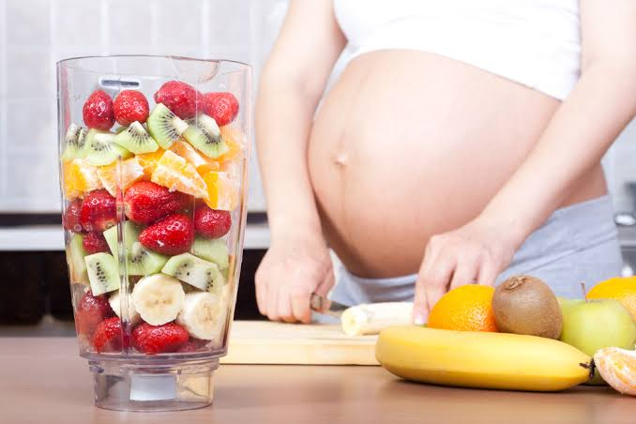
Nutrition Intervention
Goals Of Medical Nutrition Therapy
To provide adequate nutrition to improve the patients medical condition.
To restore blood sugar level to within normal range.
To avoid further complications before and after delivery.

Slide 36
NUTRITION INTERVENTION
Diet Prescription
Patient was placed on a calorie controlled DD LF LS diet of 2200kcal/day
Daily calorie requirement for moderately active females(31-50) is 2,000kcal (USDA, 2021)
Calorie Allowance during pregnancy according to Institute of Medicine (IOM)
Second Trimester-340kcal
Third Trimester-452kcal

Slide 37
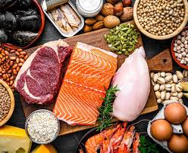
CALORIE DISTRIBUTION OF A DAY SAMPLE MENU BASED ON 2200Kcal DIET
CHO: 50% of 2200kcal = 1,100 kcal
1100 / 4 = 275g
Protein: 20% of 2200kcal = 440kcal
440 / 4 = 110g
Fat: 30% of 2200kcal = 660kcal
660 / 9 = 73g

Slide 38
A DAY SAMPLE MENU
 | FOOD | QUANTITY | KCAL (2400) | CHO(g) (300g) | CHON (g) (120g) | FAT (g) (80g) | Sodium(mg) (500mg)
Breakfast | BREAD MILK LIPTON COLESLAW 1 WHOLE EGG | 150g 14g - 20g 50g | 369.88 21.6 - 68 88 | 75 15 - 15 0.6 | 10.92 1.58 - 3 6.5 | 5.26 0.72 - - 6.79 | 260 3.03 - 19.5 6
Mid Morning Snacks | GROUNDNUT BANANA | 30g 100g | 170 103 | 7.5 22.5 | 5.52 1.09 | 13.68 0.33 | 0.72
Lunch | GARRI OKRO SOUP BEEF | 300g 250 60g | 296.22 230 188.4 | 60 15 - | 2.04 9 18.36 | 0.9 3.6 12.78 | 5.1 60 -
Mid Afternoon Snack | ORANGE | 140g | 66 | 15 | 1.3 | 0.2 | 2.8
Supper | BEANS RICE VEG. SAUCE FISH | 140g 130g 200g 90g | 206.58 172.55 103 139.5 | 30 30 15 - | 16.25 3.45 4 26.82 | 0.7 0.33 7 3.6 | 7.42 0.85 24 62
Bed Time Snack | YOGURT KEMP CRACKERS | 1 cup 18g | 66 149 | 15 15 | 1.75 8.5 | 1.68 8 | 2.1 2
 | TOTAL |  | 2226.73 | 330.6 | 120.08 | 65.57 | 455.52

Slide 39
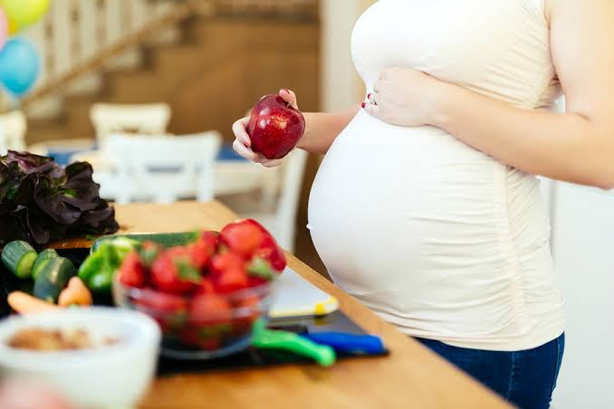
NUTRITION COUNSELLING
Patient was counselled to avoid artificial spices in her meals and to stop adding salt at table.
Patient was counselled on the need to eat protein rich foods to make up for the losses in urine.
To increase fibre intake through the consumption of fruits, vegetables, whole grain cereals.

Slide 40
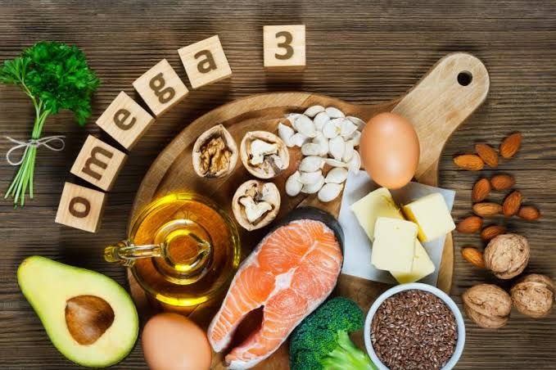
Patient was counselled on DASH diet
Patient was counselled to take foods rich in Omega 3 fatty acids (nuts, fish, flax seeds, Avocado etc) and leafy vegetables
Eat green leafy vegetables with vitamin C rich sources in order to improve the bioavailability of iron.
Patient was counselled to avoid packaged foods.

Slide 41
Drugs-Nutrient Interaction And Their Functions
Drugs | Dosage | Functions | Drug and Nutrient interaction
IM Nifediphine (20mg) | 12 hourly | Used to treat high blood pressure and to control angina (chest pain) | Longer use causes edema, grapefruits may increase the effects of the drug by increasing the amount in the body.
IM MgSO4 (5mg) | 4 hourly | It is used as an anticonvulsant and an electrolyte replenisher | Calcium react with magnesium sulphate resulting in precipitation of the sulfates
Tab Vitamin C (500mg) | 2x daily | Helps to protect cells and keep them healthy | Enhances the absorption of dietary iron and selenium, reduces copper, nickel and manganese absorption
Tab CaCO3 600mg | 3x daily | Helps in normal functioning of the nerves, cells, muscles and bones | Absorption may increase with food. Binds with phosphorus in the gut and block its absorption
Tab Propanolol (80mg) | 2x daily | A beta blocker used to treat high blood pressure, irregular heartbeats, migraine headaches or tremors | Caffeine containing foods may decrease its effectiveness when taken together
Tab Aldoment (1g) | 12 hourly | Used to treat high blood pressure, renal impairment and hypertensive crisis | Interferes with excess salt intake. Alcohol may increase dizziness when taken with drugs.

Slide 42

Nutrition Monitoring And Evaluation
Patient adhered to the new dietary regimen
On 10/11/24, patients BP was 120/80mmHg
Patient complained of heartburn and she was advised to
Eat small, frequent meals, drink liquids between meals, sit up while eating and wait 3 hours after eating before lying down

Slide 43

Nutrition Monitoring And Evaluation
On 12/11/24 Oedema gradually regressed
Patient was discharged on 14/11/24 . Blood pressure was 120/80 mmHg

Slide 44

Other Medical Professionals Involved
Doctors
Nurses
Lab. Scientists
Radiographers

Slide 45
REFRENCES
American College of Obstetricians and Gynecologists: ACOG Practice Bulletin No. 202: Gestational Hypertension and Preeclampsia, Obstet Gynecol 133: e1–e25, 2019.
American Dietetic Association, American Society of Nutrition, SiegaRiz AM, King JC. Position of the American Dietetic Association and American Society for Nutrition: Obesity, Reproduction, and Pregnancy Outcomes. J Am Diet Assoc. 2009;109(5):918-927
Goodnight W, Newman R, Society of Maternal-Fetal Medicine: Optimal nutrition for improved twin pregnancy outcome, Obstet Gynecol 114: 1121–1134, 2009
Sibai, B. M. (2004). Magnesium sulfate prophylaxis in preeclampsia: Lessons learned from recent trials. American Journal of Obstetrics & Gynecology, 190(6), 1520–1526. Retrieved November 14, 2018, from https://www.ncbi.nlm.nih.gov/pubmed/15284724
Szymanski LM, Satin AJ: Strenuous exercise during pregnancy: is there a limit? Am J Obstet Gynecol 207:179.e1-e6, 2012.
National Institute of Neurological Disorders and Stroke. (2016). The epilepsies and seizures: Hope through research. Retrieved January 4, 2017, from https://www.ninds.nih.gov/Disorders/Patient-Caregiver-Education/Hope-Through-Research/Epilepsies-and-Seizures-Hope-Through
Preeclampsia Foundation. (2018). FAQs. Retrieved November 14, 2018, from https://www.preeclampsia.org/health-information/faqs
Thangaratinam S, Rogozinska E, Jolly K, et al.. Effects of interventions in pregnancy on maternal weight and obstetric outcomes: meta-analysis of randomised evidence. BMJ 2012;344:e2088. 10.1136/bmj.e2088
United States Department of Health and Human Services, Office on Women’s Health: Postpartum depression, 2018b. Available at: https://www.womenshealth.gov/mental-health/mental-health-conditions/postpartum-depression.

Slide 46


